Slide 1
Computer Organization and Assembly Fall 2019
Lecture 1 + 2
Syeda Farwa Batool

Slide 2
What is Assembly Language
Most of programs these days are written in high level languages for example C, C++, Java, python etc.
Writing these programs is much easier than machine code.
Assembly is a language which is close to machine language.
We all knows computer can understand only 0’s and 1’s
In assembly language we have different sets of instructions to perform different tasks (like each language has some syntax).
So in assembly each instruction or operation has some binary code.
For example
SUB AX, BX =>
Computer can easily understand that code, that’s why assembly language is close to machine.
0 | 0 | 1 | 0 | 1 | 0 | 1 | 1 | 1 | 1 | 0 | 0 | 0 | 0 | 1 | 1

Slide 3
Why Assembly Language
Following are some reasons for studding assembly language.
Assembly language helps use to optimize out code.
Optimization can be done in term of space.
Optimization can be done in term of Time.
Optimization can be done in term of Processing speed.
Good for real time applications
Precise coding (Not less and Not more ), help to make good logic
What is the limitation for High level languages to become optimized

Slide 4
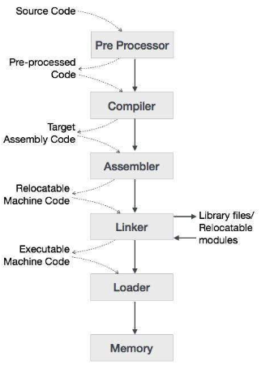
Source to Machine Code
Ref: https://www.tutorialspoint.com/compiler_design/compiler_design_overview.htm

Slide 5
Number System Used in Assembly
Binary Numbers
Base is 2
0 and 1 is allowed
Hexadecimal Numbers
Base is 16
0,1,2,3,4,5,6,7,8,9,A,B,C,D,E,F is allowed
Some Notations
A group of 4 bits is called nibble
A group of 8 bits is called byte
A group of 2 bytes is called word
A group of 2 words is called Double or Doubleword

Slide 6
Microprocessors and 8086 family
In any microcomputer, the component which actually process data is entirely contained on a single silicon chip is called microprocessor. There are many different kinds of microprocessor just as there are different makes of computer. Intel Corporation, manufactured 8086 in the late 1970s.
Major Members of 8086 family
Increasing Computer Power | 8086 (8088 is functionally the same but less powerful and cheaper than 8086)
 | 80186 (80188 is functionally the same but less powerful and cheaper than 80186)
 | 80286
 | 80386
 | 8046

Slide 7
Encoding of 8086 Instructions
8086 Instructions are represented as binary numbers
Instructions require between 1 and 6 bytes. (max size can be 6*8 = 48 bits)
Note that some architectures have fixed length instructions. For example MIPS (study later)
Bytes | 7 | 6 | 5 | 4 | 3 | 2 | 1 | 0
1 | Opcode |  |  |  |  |  | d | w
2 | mod |  | reg |  |  | r/m
3 | [optional]
4 | [optional]
5 | [optional]
6 | [optional]
Opcode byte
Addressing mode byte

Slide 8
[cont.]
Note that bytes 1 and 2 are divided up into 6 fields:
opcode
d direction (or s = sign extension)
w word/byte
mod mode
reg register
r/m register/memory

Slide 9
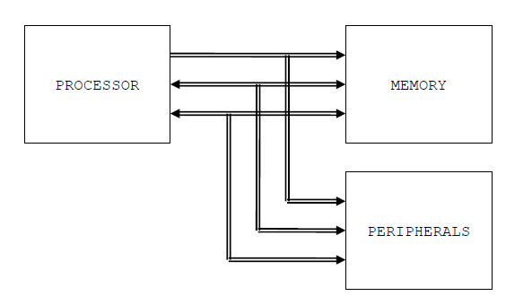
Basic Architecture of Commuter
Ref: Text book 1
Notes:
First line is address bus which data (data address)
Second line is data bus (size depends on cell width)(cell width is maximum bits a cell of a memory can store)
Third line of control bus, signal is generated either read data or write data (if any hazard occur at memory side so memory need to inform processor so it is bidirectional)

Slide 10
Size of Address & Data Bus
8086 is 16-bit microprocessor. So size of Data bus is 16 bit
8086 has 20-bit address bus. Because 8086 can access up to 1 Mb of memory which is
1,048,576 bytes (2²⁰ = 1,048,576)

Slide 11
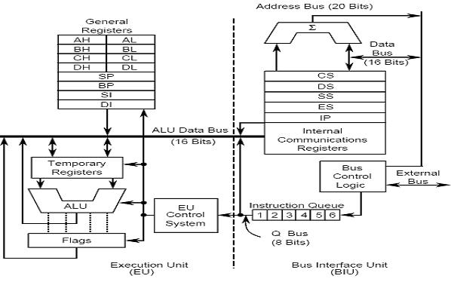
Insight view of Processor
Ref: https://electronics.stackexchange.com/questions/167391/buses-in-8086-micro-processor

Slide 12
Instruction Execution Cycle
Instruction Fetch
Obtain instructions from program Storage
Infinite Cycle
Instruction Decode
Determine required action and instruction size
Operand Fetch
Locate and obtain operand data
Execute
Compute result value and status
Write Back Result
Save result in memory/register for further use

Slide 13
Registers
A temporary storage places inside the processor called registers.
Registers are like a scratch pad ram inside the processor and their
operation is very much like normal memory cells. They have precise locations and remember what is placed inside them. They are used when we need more than one data element inside the processor at one time.
Memory is a limited resource but the number of memory cells is large. Registers are relatively very small in number
Each register is 16 bit register.

Slide 14
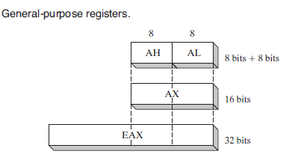
Cont.
We have 4 general purpose register in 8086.
AX (Accumulator Register)
BX (Base Register)
CX (Counter Register)
DX (Destination Register as it acts as the destination in I/O operations)
Ref: reference book

Slide 15
Cont.
We have 2 Index register in 8086.
SI (Source Index)
DI (Destination Index)
We have 3 pointer register in 8086.
SP (Stack Pointer)
BP (Base Pointer)
IP (Instruction Pointer also called program counter holds the address of next instruction)
We have 3 Segment Registers in 8086
Code , Data, Stack, and Extra segments

Slide 16
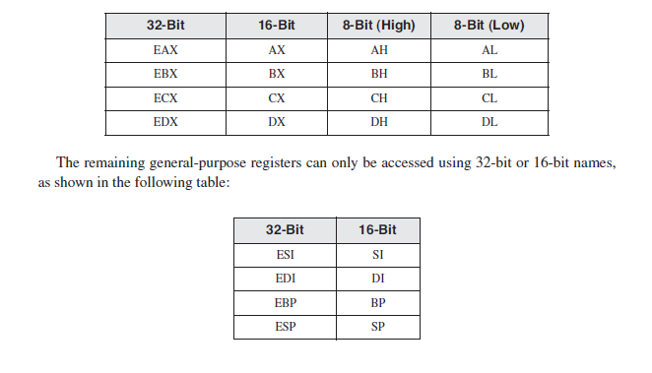
Cont.
Ref: reference book

Slide 17
Flag register
Status Flags The status flags reflect the outcomes of arithmetic and logical operations performed by the CPU.
The Carry flag (CF) is set when the result of an unsigned arithmetic operation is too large to fit into the destination.
The Overflow flag (OF) is set when the result of a signed arithmetic operation is too large or too small to fit into the destination.
The Sign flag (SF) is set when the result of an arithmetic or logical operation generates a negative result.
The Zero flag (ZF) is set when the result of an arithmetic or logical operation generates a result of zero.
The Auxiliary Carry flag (AC) is set when an arithmetic operation causes a carry from bit 3 to bit 4 in an 8-bit operand.
The Parity flag (PF) is set if the least-significant byte in the result contains an even number of 1 bits. Otherwise, PF is clear. In general, it is used for error checking when there is a possibility that data might be altered or corrupted.
Notes:
Carry Flag Sets when 2 things happes
a) two unsigned numbers were added and the result is larger than "capacity" of register where it is saved. Example: we wanna add two 8 bit numbers and save result in 8 bit register. In your example: 255 + 9 = 264 which is more that 8 bit register can store. So the value "8" will be saved there (264 & 255 = 8) and CF flag will be set.
b) two unsigned numbers were subtracted and we subtracted the bigger one from the smaller one. Example: 1-2 will give you 255 in result and CF flag will be set.
Overflow Flag is used as CF but when we work on signed numbers. Example we wanna add two 8 bit signed numbers: 127 + 2. the result is 129 but it is too much for 8bit signed number, so OF will be set. Similar when the result is too small like -128 - 1 = -129 which is out of scope for 8 bit signed numbers.

Slide 18
Cont.
Control Flags Control flags control the CPU’s operation. For example, they can cause the CPU to break after every instruction executes, interrupt when arithmetic overflow is detected, enter virtual-8086 mode, and enter protected mode.
Trap Flag
Direction Flag
Specifically related to string instructions, this flag tells whether the current operation has to be done from bottom to top of the block (D=0) or from top to bottom of the block (D=1).
Interrupt Flag

Slide 19
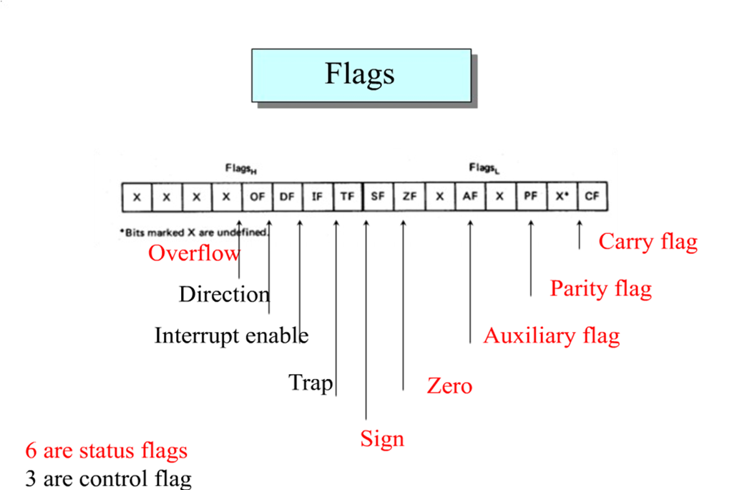
Cont.

Slide 20
Instruction Group
Data Movement Instructions
Mov
Lad (LOAD)
Arithmetic and Logic Instructions
Add , Sub, etc.
AND, OR, XOR, SHL, SHR , etc.
Program Control Instructions
Jmp (Jump)
call
Special Instructions
cli
sti
Where cli clears the interrupt flag and sti sets it.

Slide 21
First Assembly Program
English Version of Program
move 5 to ax
move 10 to bx
add bx to ax and save result in ax
move 15 to bx
add bx to ax and save result in ax

Slide 22
Basic Syntax of Assembly
operation destination, source
operation destination
operation source
operation

Slide 23
Assembly Version
;a program to add three numbers using registers
[org 0x0100]
mov ax, 5 ; load first number in ax
mov bx, 10 ; load second number in bx
add ax, bx ; accumulate sum in ax
mov bx, 15 ; load third number in bx
add ax, bx ; accumulate sum in ax
mov ax, 0x4c00 ; terminate program
int 0x21

Slide 24
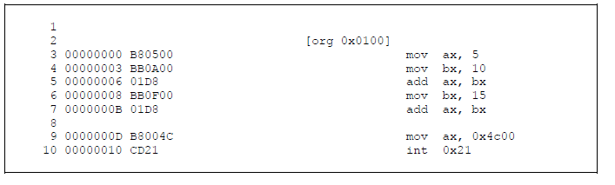
Reading Listing File

